Slide 1
UNIT II DIVIDE AND CONQUER
Session – 10

Slide 2
Syllabus
Introduction, Binary Search - Merge sort and its algorithm analysis - Quick sort and its algorithm analysis - Strassen's Matrix multiplication - Finding Maximum and minimum - Algorithm for finding closest pair - Convex Hull Problem

Slide 3
Introduction
Divide / Break
Conquer / Solve
Merge / Combine

Slide 4
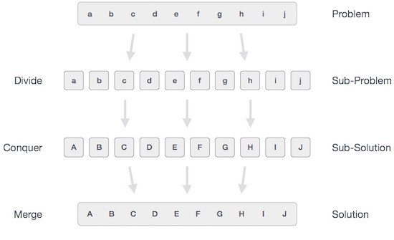

Slide 5
Merge Sort algorithm
Merge sort is based on Divide and conquer method.
It takes the list to be sorted and divide it in half to create two unsorted lists.
The two unsorted lists are then sorted and merged to get a sorted list.
The two unsorted lists are sorted by continually calling the merge-sort algorithm; we eventually get a list of size 1 which is already sorted. The two lists of size 1 are then merged.
Steps using Divide and Conquer strategy
Step 1 − if it is only one element in the list it is already sorted, return.
Step 2 − divide the list recursively into two halves until it can no more be divided.
Step 3 − merge the smaller lists into new list in sorted order.

Slide 6
MergeSort(arr[], l, r)
If r > l
1. Find the middle point to divide the array into two halves:
middle m = (l+r)/2
2. Call mergeSort for first half:
Call mergeSort(arr, l, m)
3. Call mergeSort for second half:
Call mergeSort(arr, m+1, r)
4. Merge the two halves sorted in step 2 and 3:
Call merge(arr, l, m, r)

Slide 7
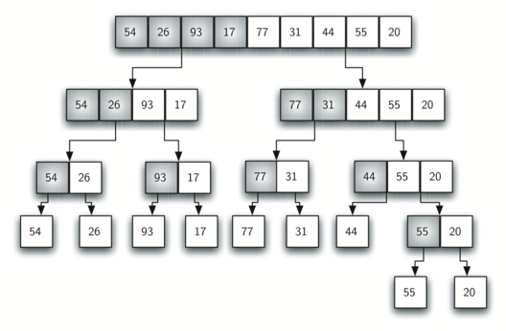
Mergesort(A,p,r)

Slide 8
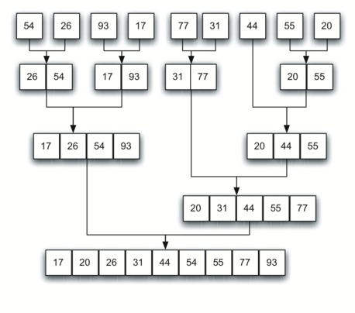

Slide 9
Mergesort() function
MERGE-SORT (A, p, r)
1. WHILE p < r // Check for base case
2. q = FLOOR[(p + r)/2] // Divide step
3. MERGE-SORT (A, p, q)
4. MERGE-SORT (A, q + 1, r)
MERGE (A, p, q+1, r)
MergeSort() function / Split step
We find the middle index using start and end index of the input array and again invoke the same function with two parts one starting from start to mid and other being from mid+1 to end.
Once base condition is hit, we start winding up and call merge function.

Slide 10
Mergesort(A,p,r)

Slide 11
Merge() function
MERGE (A, p, q, r ) //A –array, p – start index, q – middle,
r – last index
//Merges two subarrays of arr[].First subarray is arr[p..q] Second subarray is arr[q+1..r]
1. n1 ← q − p + 1
2. n2 ← r − q
// Create temperary arrays L[1 .. n1+1] and R[1 ..n2+1]
3. FOR i ← 1 to n1
4. do L[i] ← A[p + i − 1]
5. FOR j ← 1 TO n2
6. DO R[j] ← A[q + j ]
7. L[n1 + 1] ← ∞
8. R[n2 + 1] ← ∞

Slide 12
9. i ← 1
10.j ← 1
11. for k ← p to r
12. Do if L[i ] ≤ R[ j]
13. then A[k] ← L[i]
14. i ← i + 1
15. else A[k] ← R[j]
16. j ← j + 1

Slide 13
Merge() function / Merge step
Merge function merges two sub arrays (one from start to mid and other from mid+1 to end) into a single array from start to end. This array is then returned to upper calling function which then again sort two parts of array.

Slide 14
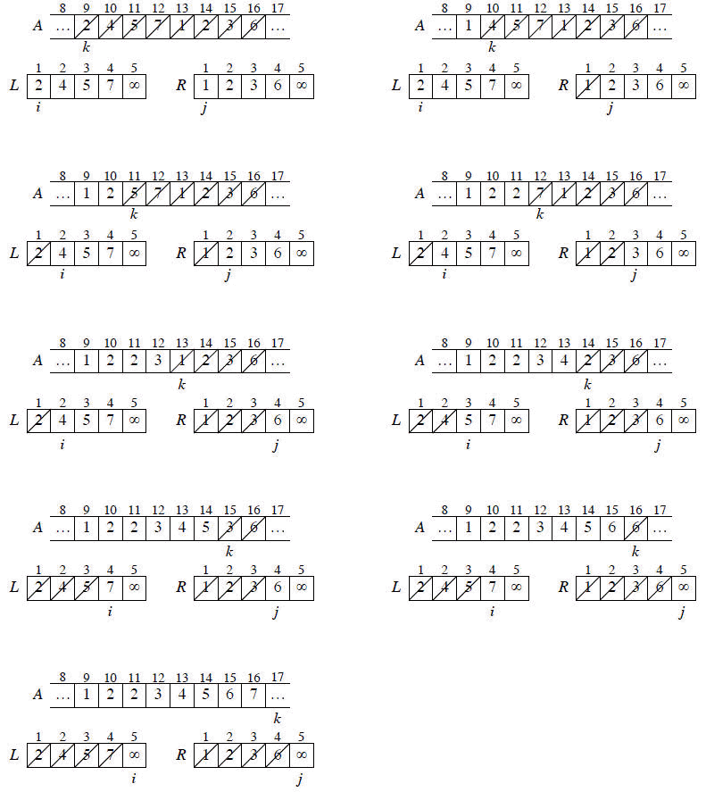

Slide 16

Merge sort analysis
For simplicity, assume that n is a power of 2 so that each divide step yields two subproblems, both of size exactly n/2.
The base case occurs when n = 1.
When n ≥ 2, time for merge sort steps:
Divide: Just compute q as the average of p and r, which takes constant time i.e. Θ(1).
Conquer: Recursively solve 2 subproblems, each of size n/2, which is 2T(n/2).
Combine: MERGE on an n-element subarray takes Θ(n) time.
Summed together they give a function that is linear in n, which is Θ(n). Therefore, the recurrence for merge sort running time is

Slide 17
Using Master’s theorem
T(n) = 2T(n/2) + ϴ(n)
T(n) = aT(n/b) + f(n) where a >= 1 and b > 1
a = 2 b = 2 f(n) = n
If f(n) < O(n^{log}_{b}ª), then T (n) = ϴ (n^{log}_{b}ª).
If f(n) = ϴ (n^{log}_{b}ªlog^{k}n) with k≥0, then T (n) = ϴ (n^{log}_{b}ªlog^{k+1}n).
If f(n) > Ω (n^{log}_{b}ª), and f(n) satisfies the regularity condition, then T (n) = ϴ (f(n)).
Calculate n^{log}_{b}ª = n^{log}₂² = n
Compare with f(n). Since f(n) = n^{log}_{b}ª
i.e. n = n
Case 2 is satisfied hence complexity is given as
T(n) = Θ(f(n)logn) = Θ (nlogn)

Slide 18
Video for Merge sort
Merge sort

Slide 19
Worksheet No. 10

